Slide 1
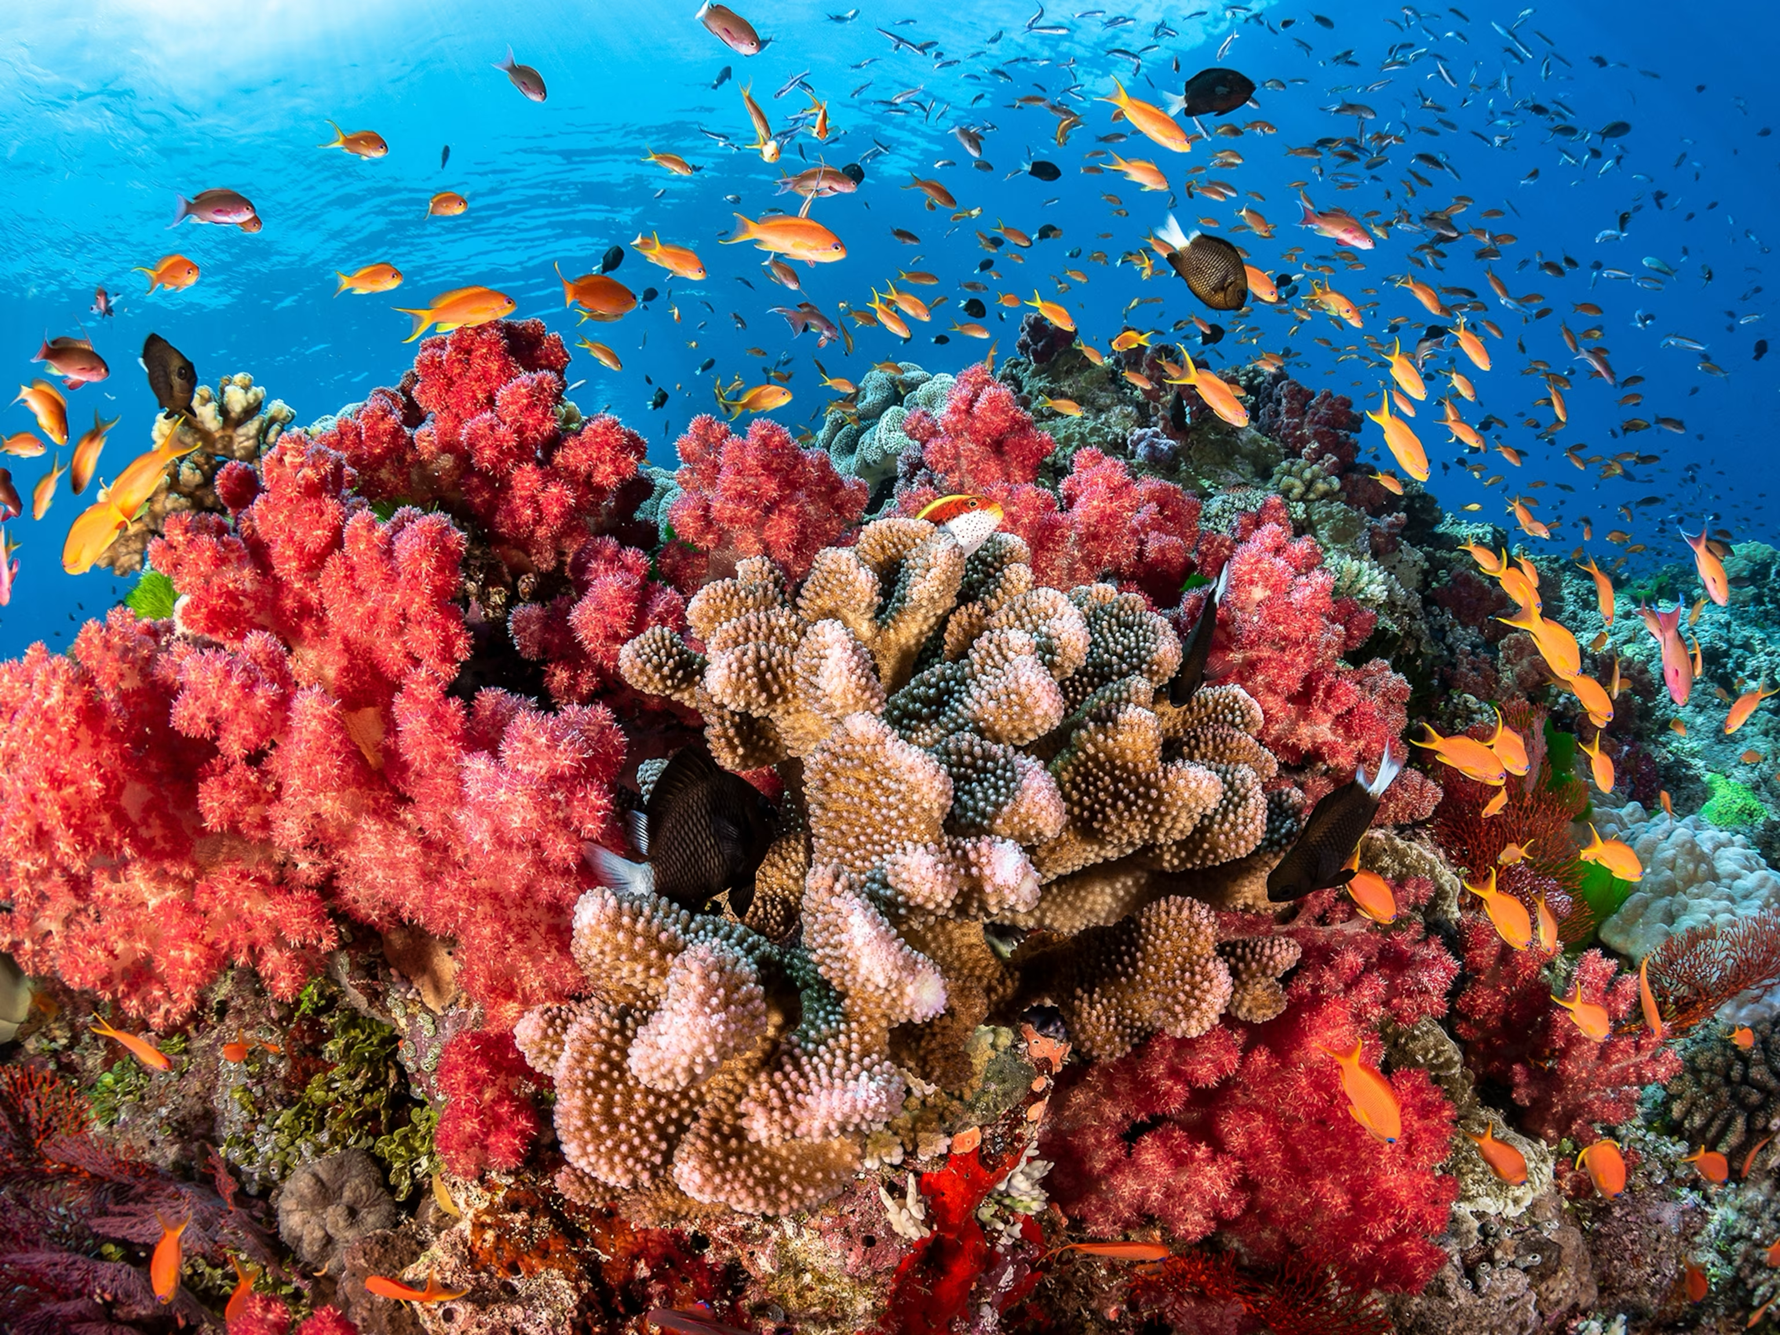
Coral Habitat Predictor: Identifying Optimal Locations for Coral Growth
Nikol Michailos, Jenny Friesenhahn, Nazanin Beheshti, Andy Metz

Slide 2
Agenda
Introduction
Data Visualization
Scaling the Data
Clusters + Predictions
Supervised Learning
Q + A

Slide 3
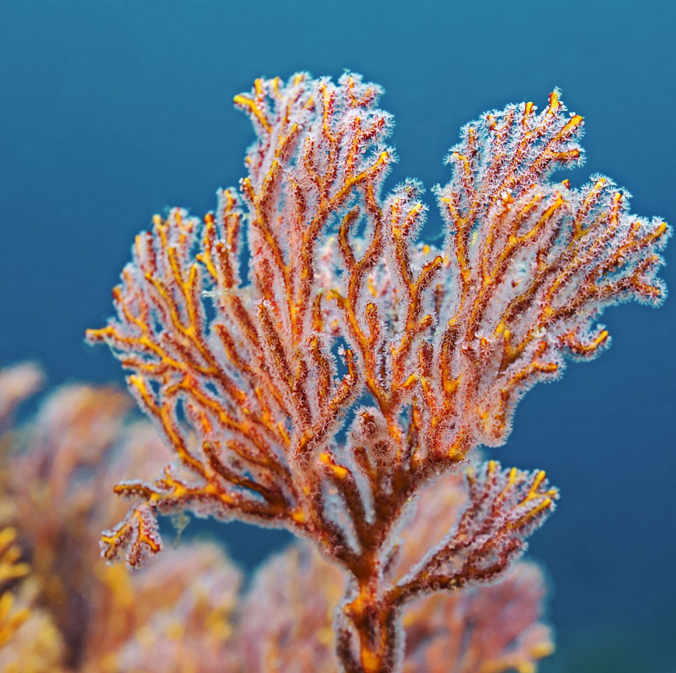
Background: What are corals and what type of aquatic environment do they prefer and thrive in?
“A hard substance formed in the sea from masses of shells of very small sea animals, usually orange or red in color”
“Coral is an animal, with plant-like cells living inside of it”
“Some corals can naturally produce fluorescent pigments that can appear as a wide array of colors”
Each coral polyp has stinging cells in its tentacles that are used like harpoons to spear floating plants and animals, called plankton.
Corals are so diverse in their shapes, sizes and colors. Mound and boulder corals grow to look like their name as enormous, round mounds on the sea floor.
Though adult corals are attached to the ocean floor, corals in the larval, or baby, life stage can swim!
Corals support 25% of ocean life--Coral are often referred to as a foundational or architect species, or ecosystem engineers, for constructing the physical spaces where animals live.
Climate Change Is the Biggest Threat to Corals. Warming waters due to climate change are putting immense stress on our vulnerable coral populations.
Corals require very saline (salty) water
Resources:
National Ocean Service
Kaggle data: https://www.kaggle.com/datasets/natalialimanska/corals-worldwide-distribution
Notes:
Nikol

Slide 4
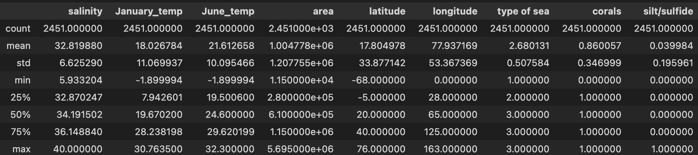
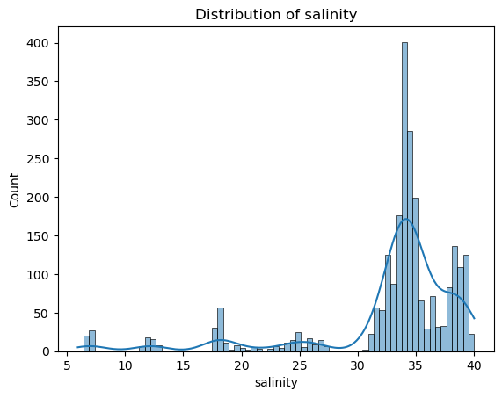
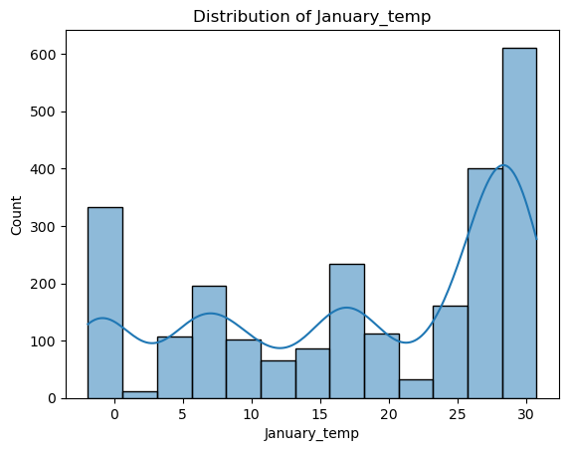
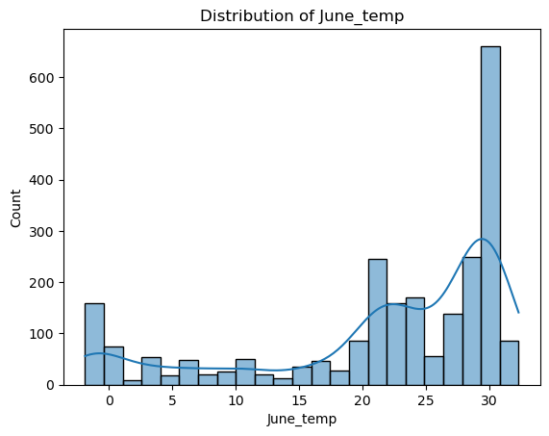
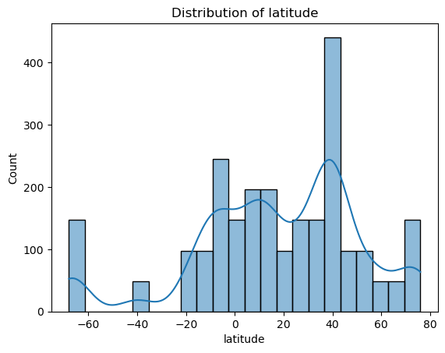
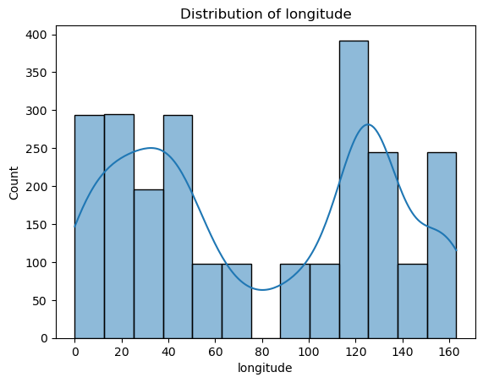
Visualizing the Features
Description of Coral DF
Resources: Data used: corals_worldwide_dataset.csv
Notes:
Andy: Charts: Summary of the data in the data frame

Slide 5
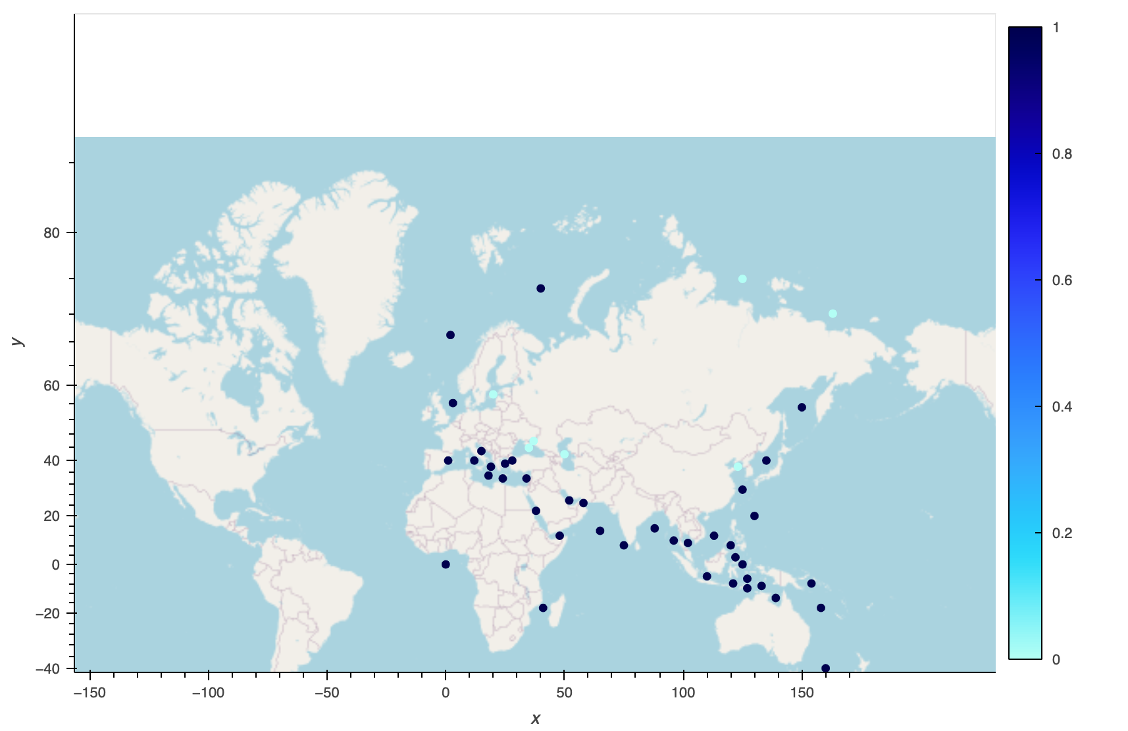
Visualizing the Features
Resources: Data used: corals_worldwide_dataset.csv
Notes:
Show the map live - Andy

Slide 6
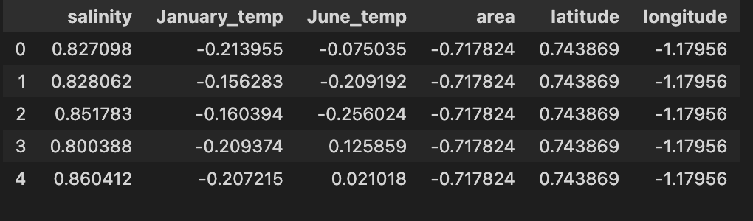

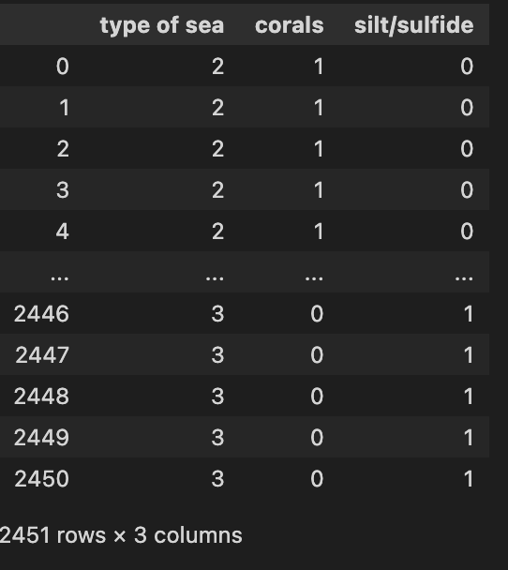
Scale the data
Scaled data in data frame
Categorical columns
Notes:
Jenny

Slide 7
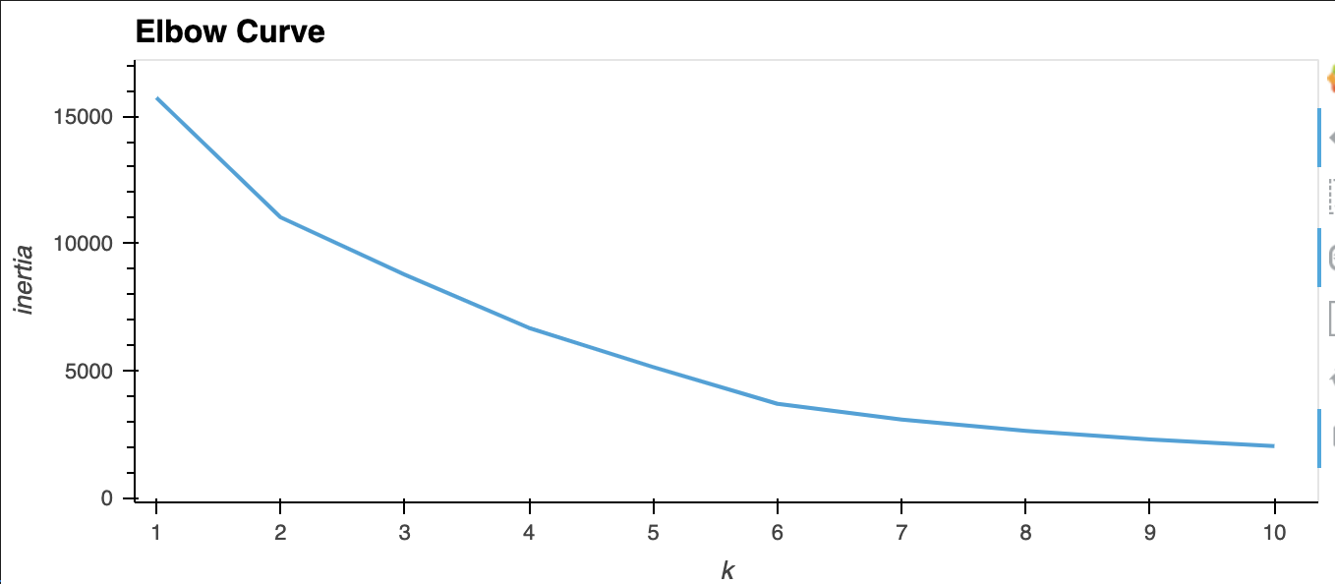
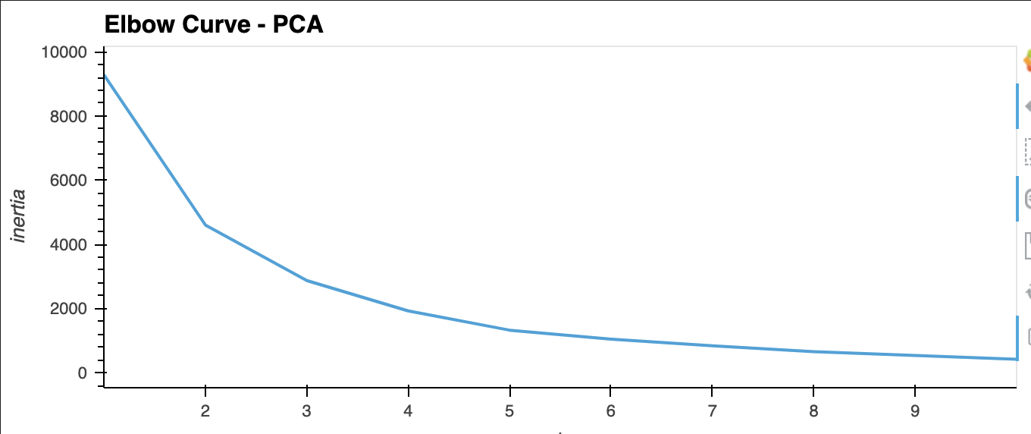
Elbow Curves for Clustering
Original Data
PCA
Notes:
Jenny

Slide 8
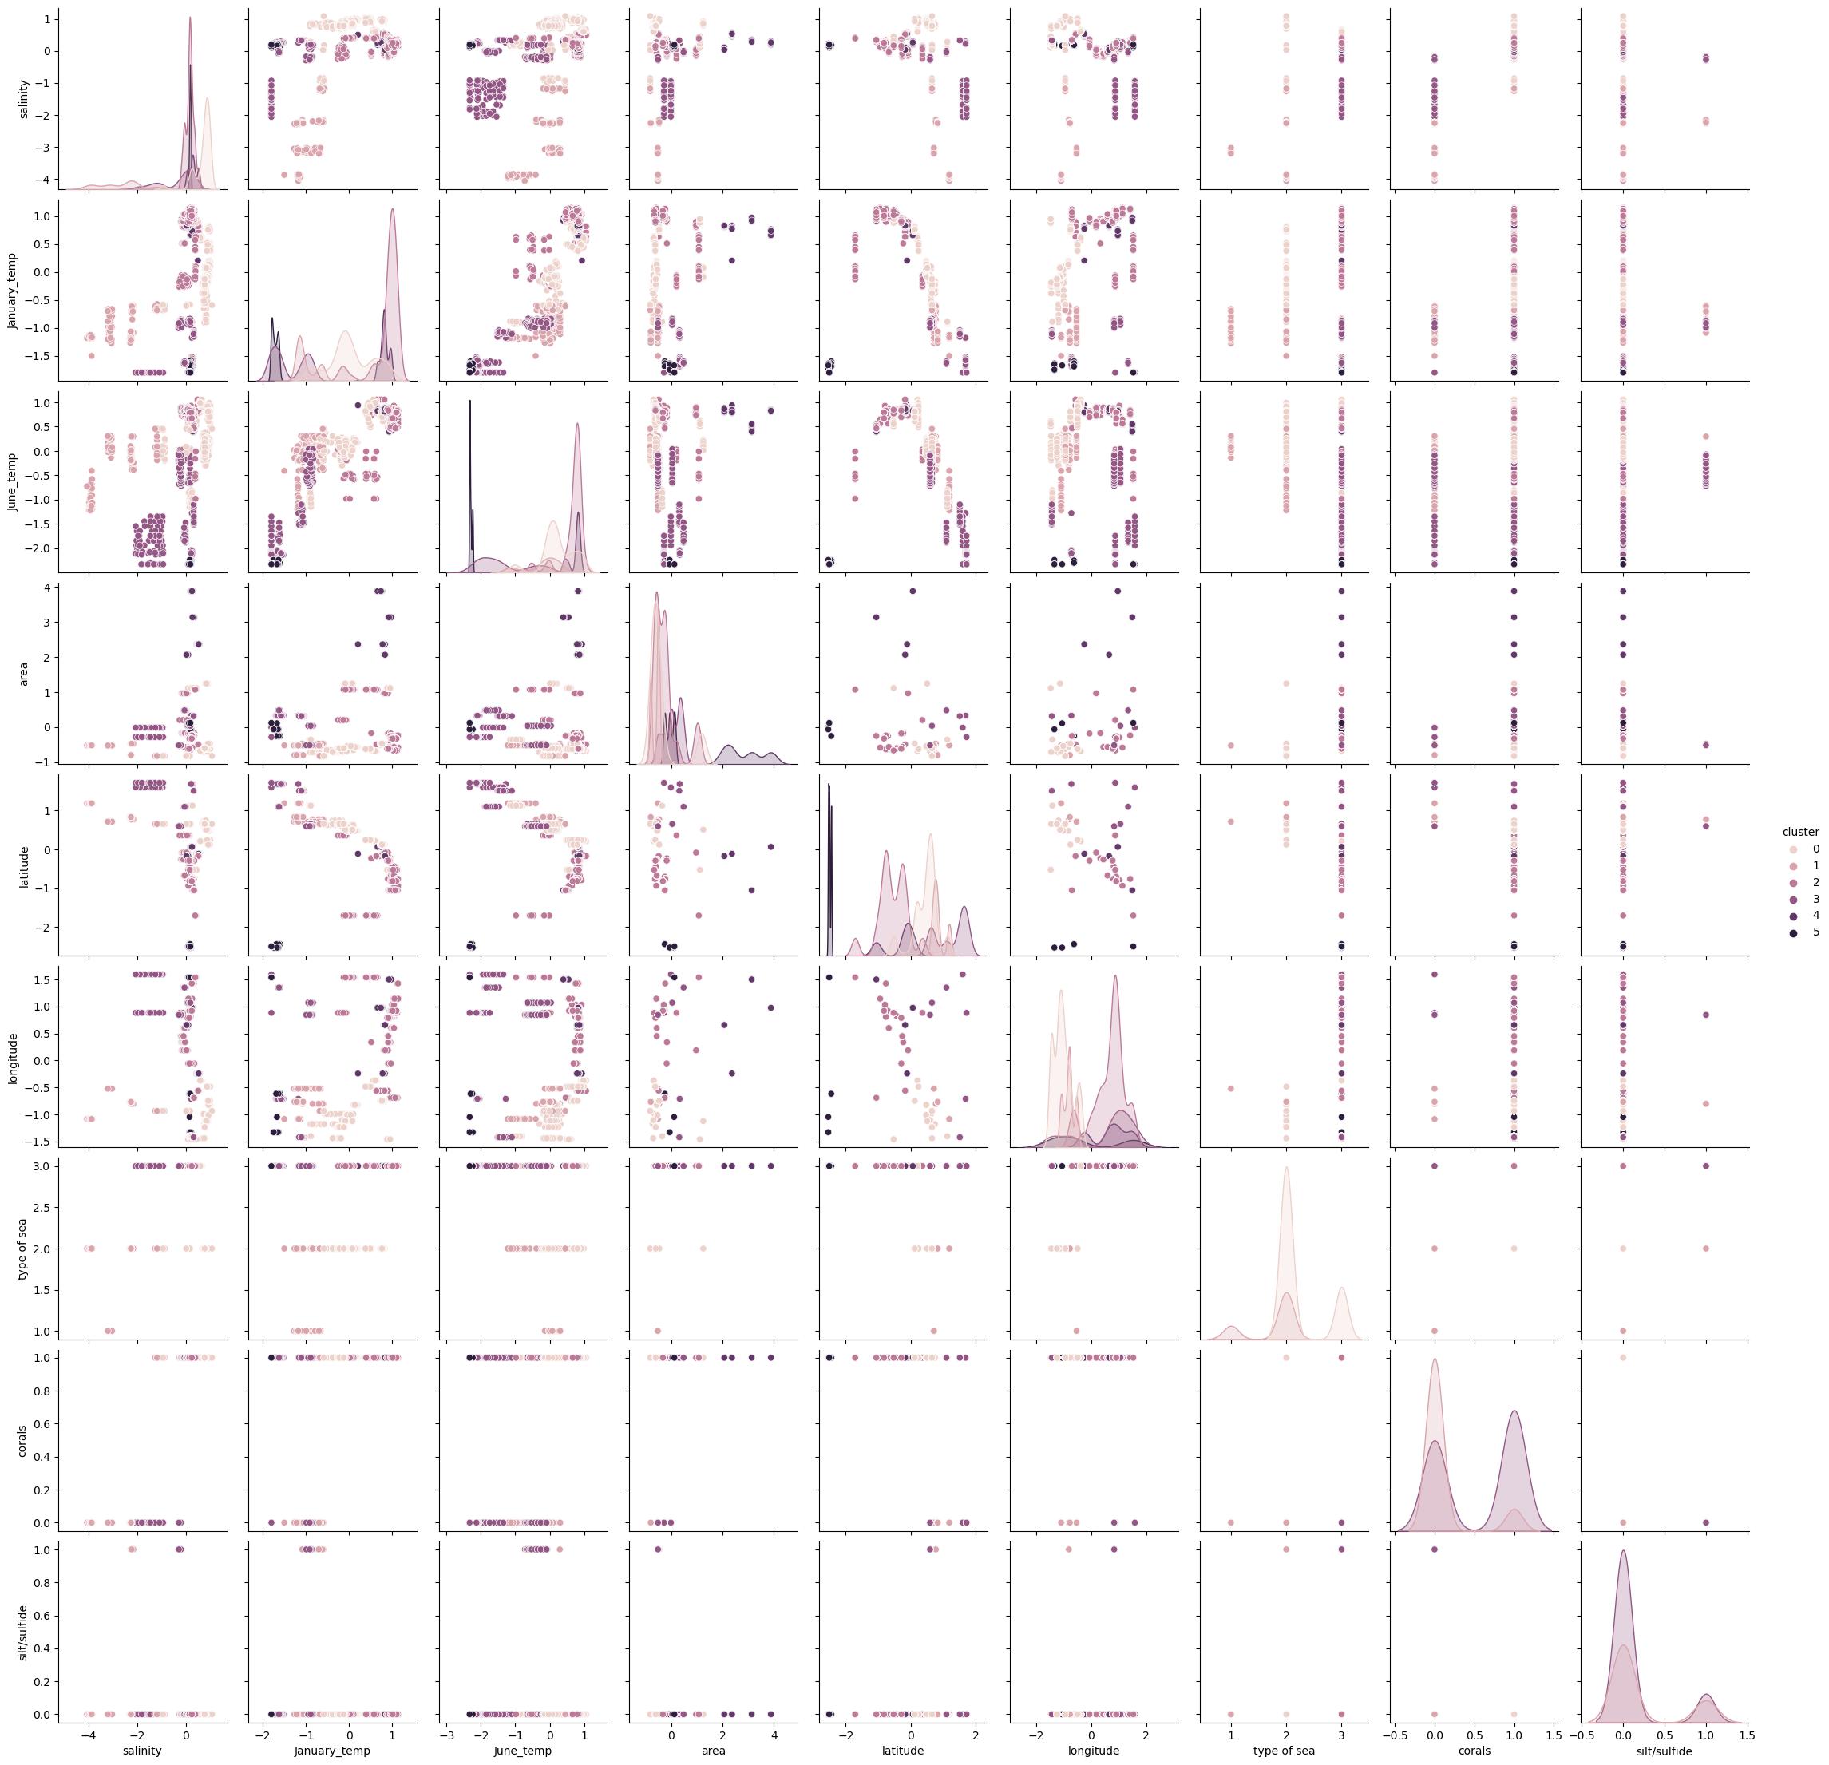
Clusters
Notes:
Jenny

Slide 9
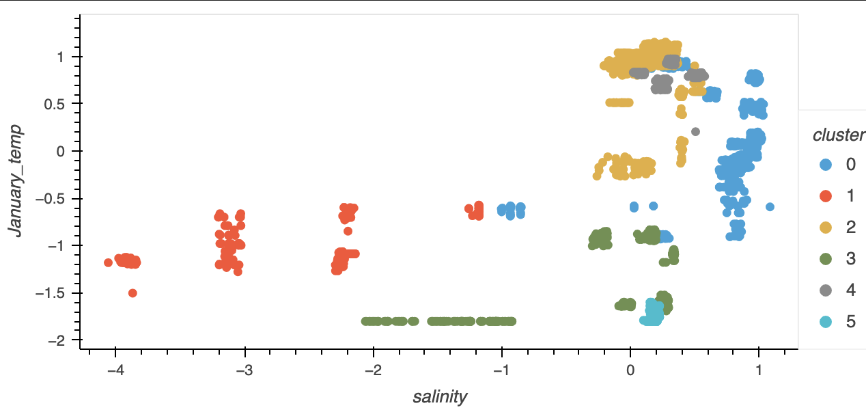
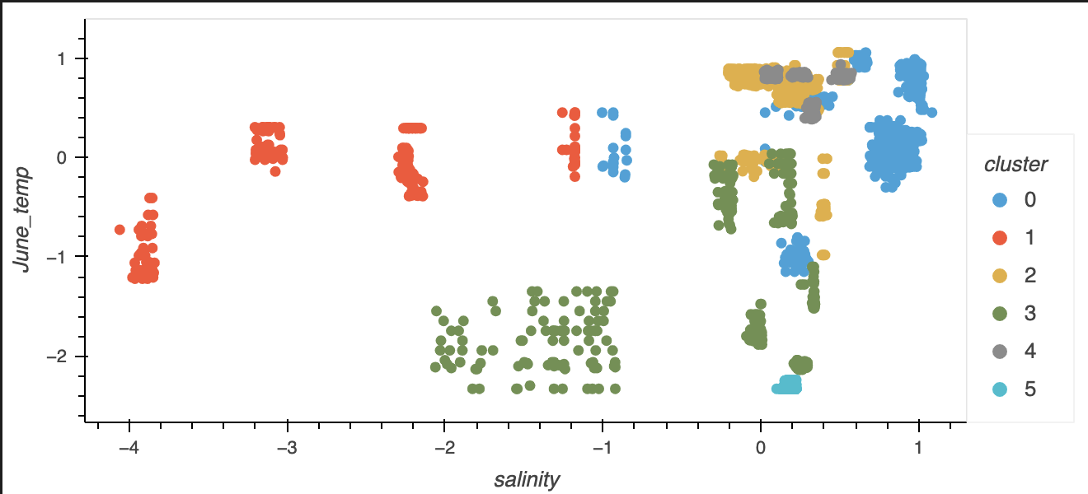
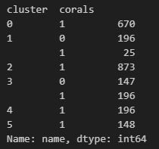
Clusters – Original Data
Notes:
Jenny

Slide 10
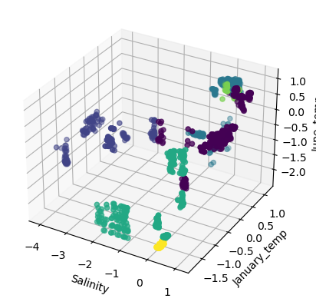
3D Cluster Visualization
Notes:
Jenny

Slide 11
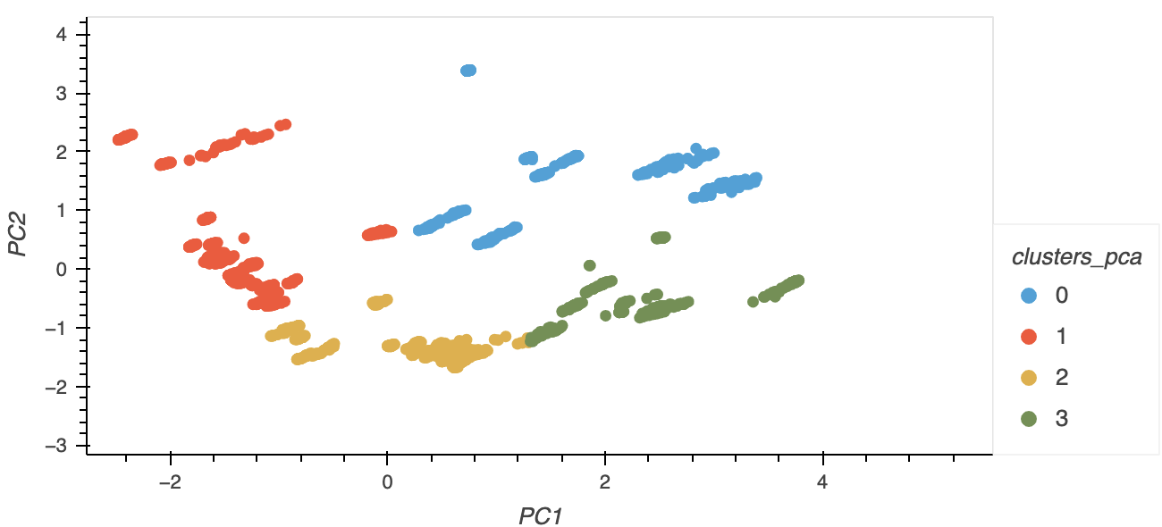
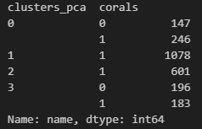
Clusters – PCA Data
Notes:
Jenny

Slide 12
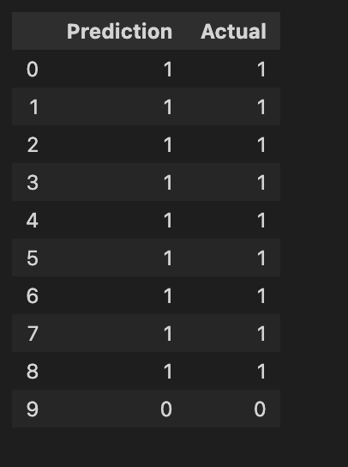
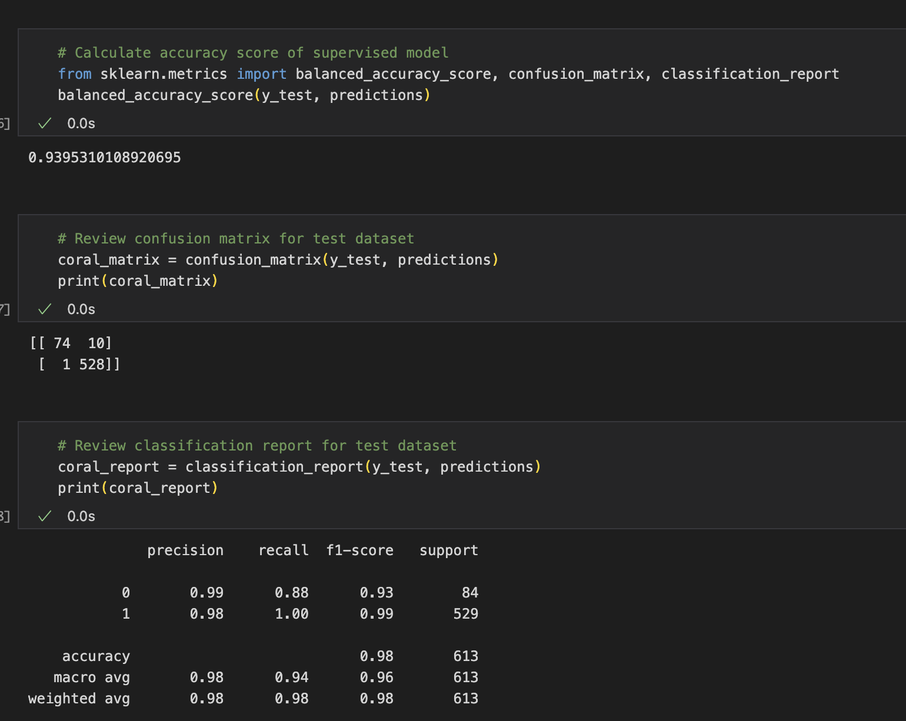
Supervised Learning
Notes:
Nazanin

Slide 13
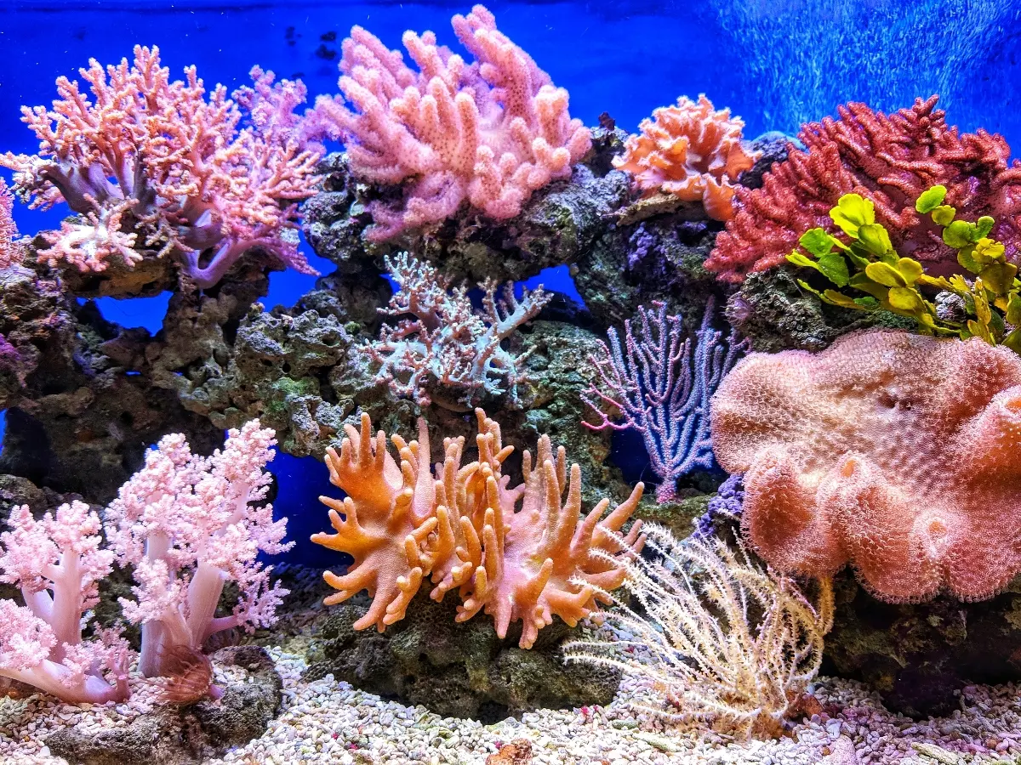
Thank you!

